Slide 1
Mission Impossible
（Really impossible！！！）
Team Members:
Secretary: Yilin Zhang; Source Management: Dier Hou; Style: Wentao Xu, Chenhao Zheng;
Requirements: ZhouWei; Testins: Yuxiang

Slide 2
This is a really tough game
Designed and devoted by a player in the game “Break Out and Attack”（《突出重围：出击》in Chinese）
Found, redesigned and implemented by a group of students(which is us!)
Really impressive!

Slide 3
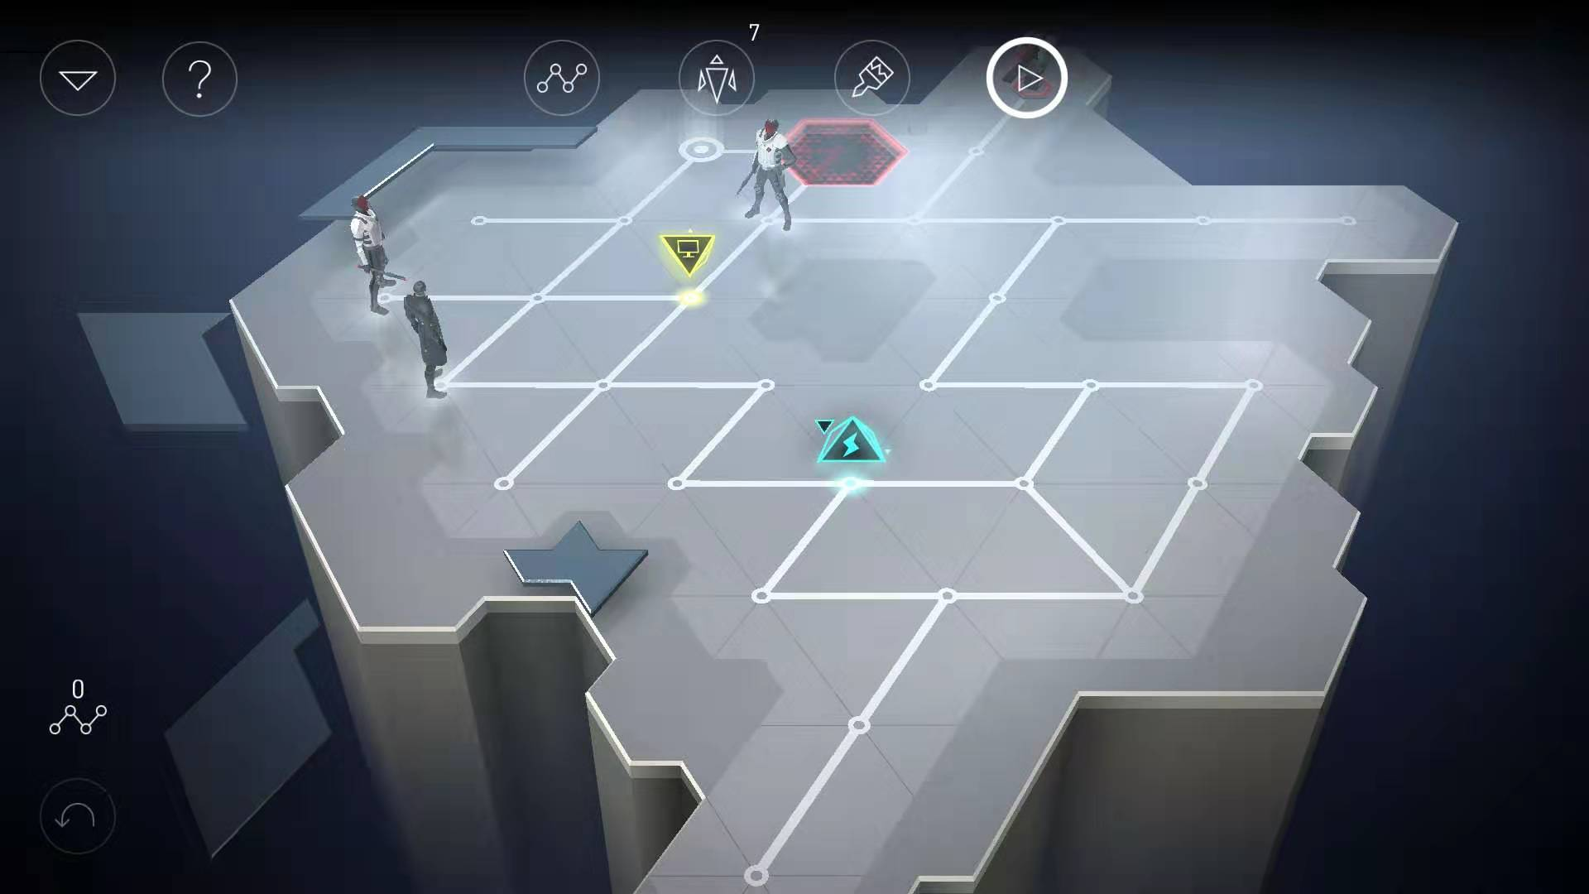
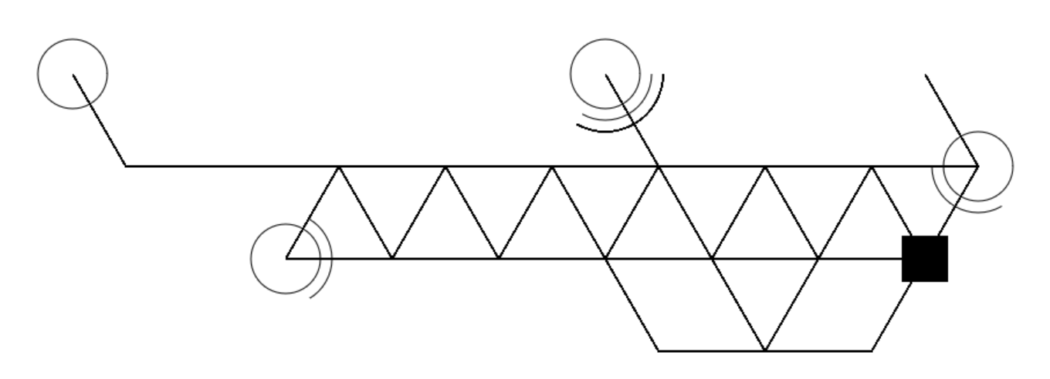
Quite Abstrct

Slide 4
First let us tell everyone :
Our goal and each one’s role in this game!

Slide 5
Structural design
Good Design
=
Good Cooperation

Slide 6
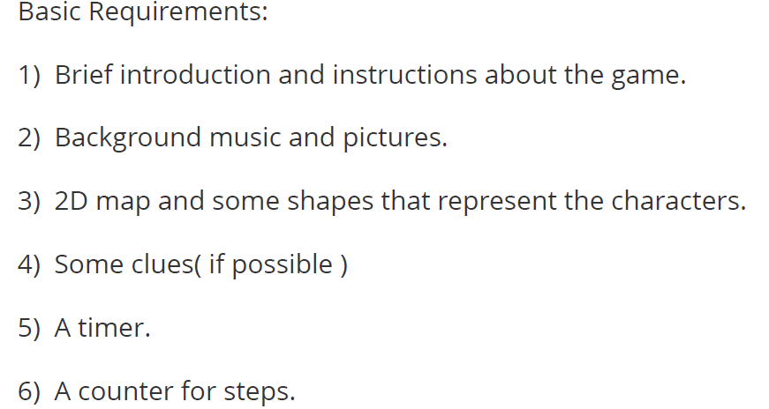
Requirements

Slide 7
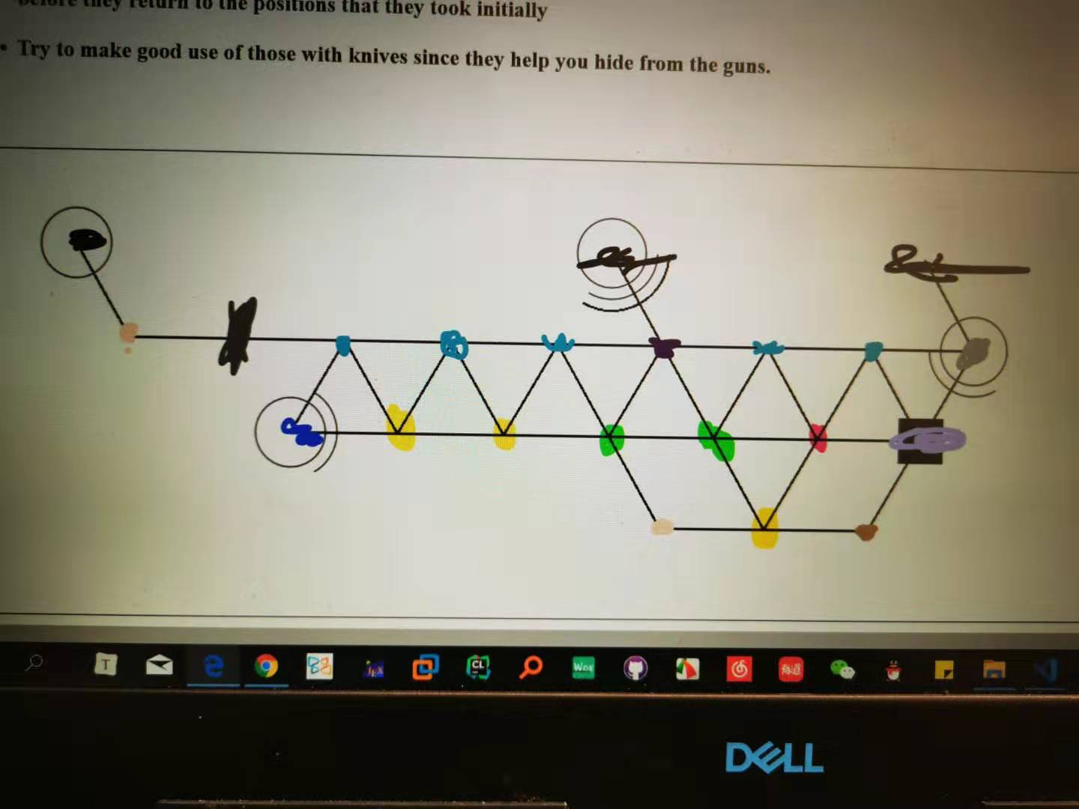
Player Movement

Slide 8
Man Move
Record player’s position
Run to the recorded position
Go back to its home
Yes
Face to player?
No
Turn to another direction

Slide 9
More detailed…
Go one step forward
The player appear again!
No
Reached the recorded place?
Re-record the player’s position
Go one step backward (go home)
Yes

Slide 10
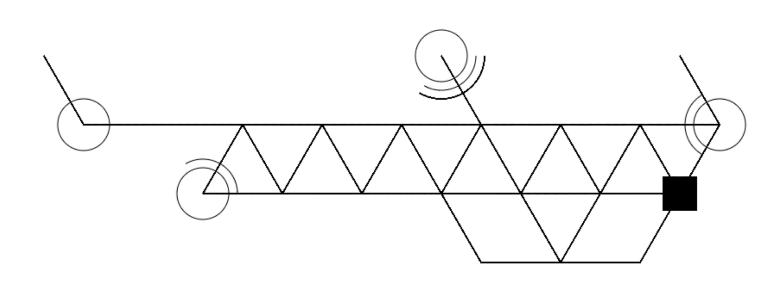

Slide 11
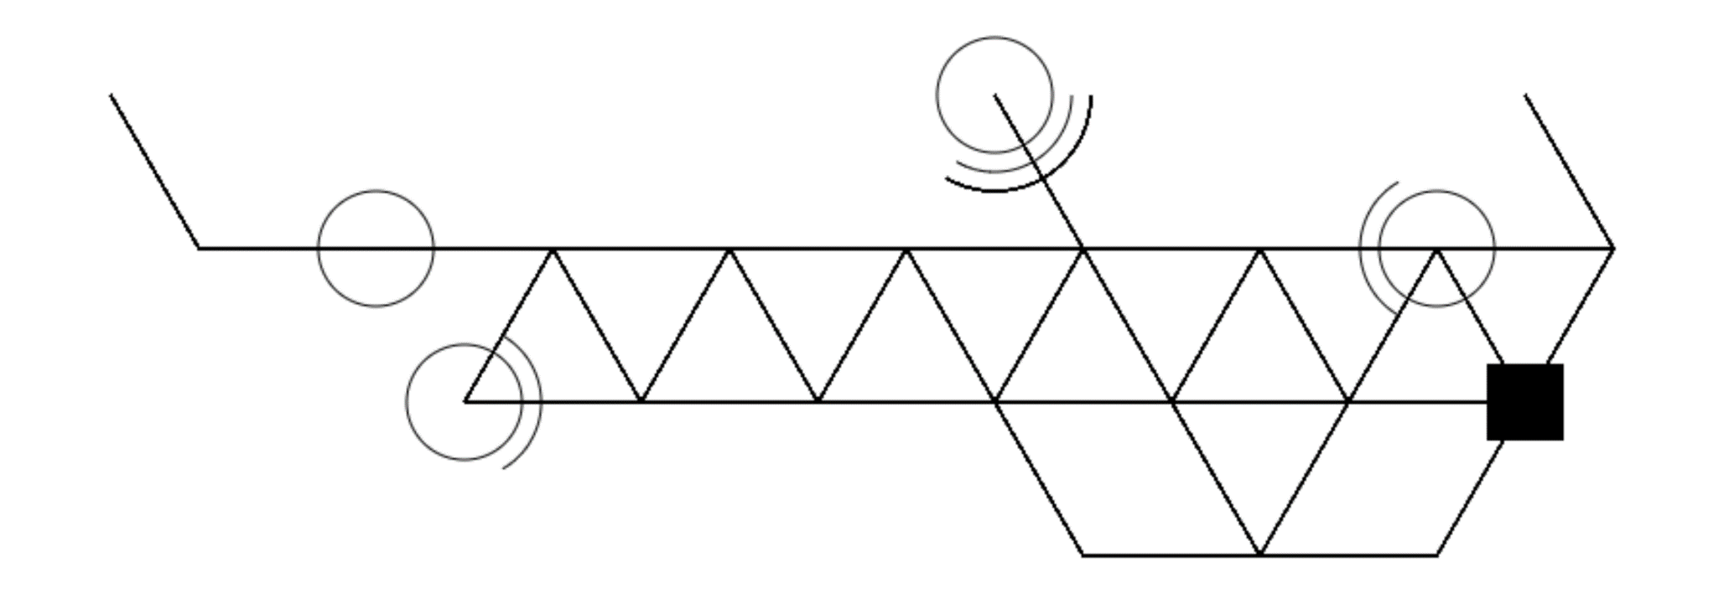

Slide 12
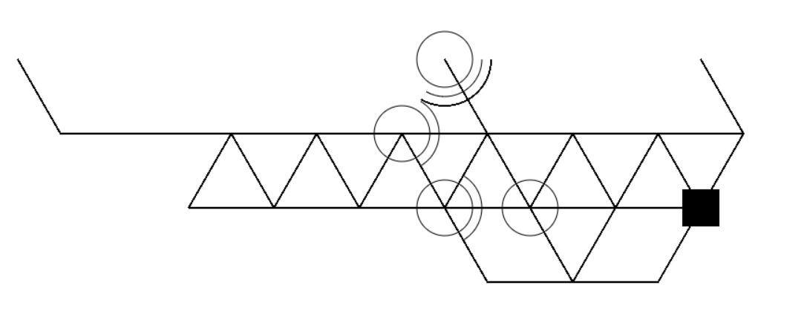
How the GUN works

Slide 13
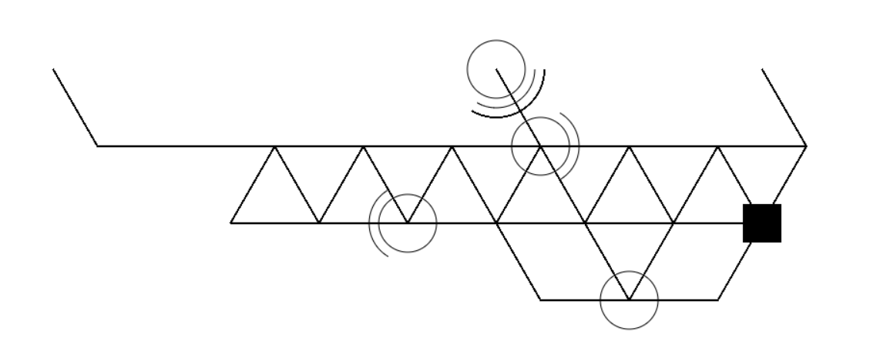
How the GUN works

Slide 14
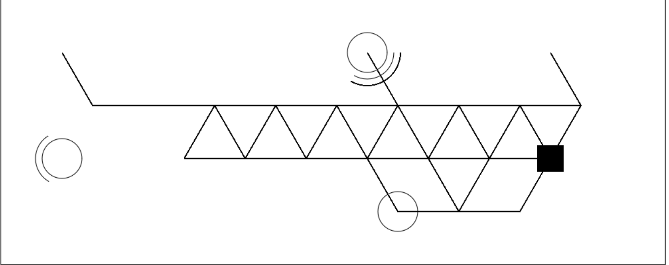
Debugs

Slide 15
Second let us tell everyone :
How to
play the game!

Slide 16
Third let us show you how to win:
Just Joking, Try it out yourself!

Slide 17
Thanks for watching! Thanks for your time!

